Slide 1
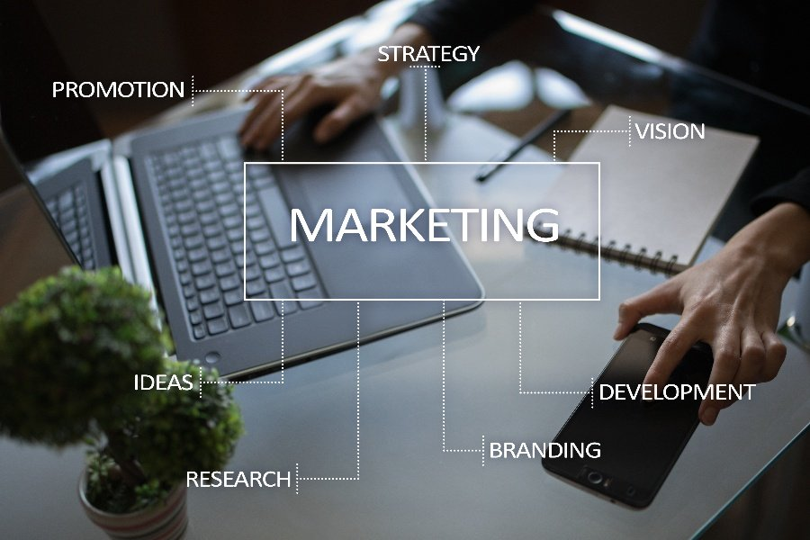
Marketing Management
Student Names: Ch. Radhika regno:192111223
B. Eswar raj regno:192111257
Department: Computer science
Subject name/code: UBA3366 principles of management

Slide 2
Abstract:
This paper presents a framework or set of ideas for using customer satisfaction principles and strategies to improve the quality responsiveness and possibility of public sector privately provided services in valuable communities. Marketing management performs the task of converting the potential customers into actual customer. This is possible through satisfaction of customer's needs and wants by delivering them, appropriate goods and services according to their needs and wants, at right time and through convenient channel. This paper provides a systematic literature review of the Marketing management domain. Based on a systematic assessment of more than 25 years of Marketing management research, the authors review the major themes discussed in the literature, identify and resolve inconsistencies and definitional ambiguities, and develop a comprehensive conceptual model that integrates and synthesizes the current body of knowledge about marketing management.

Slide 3
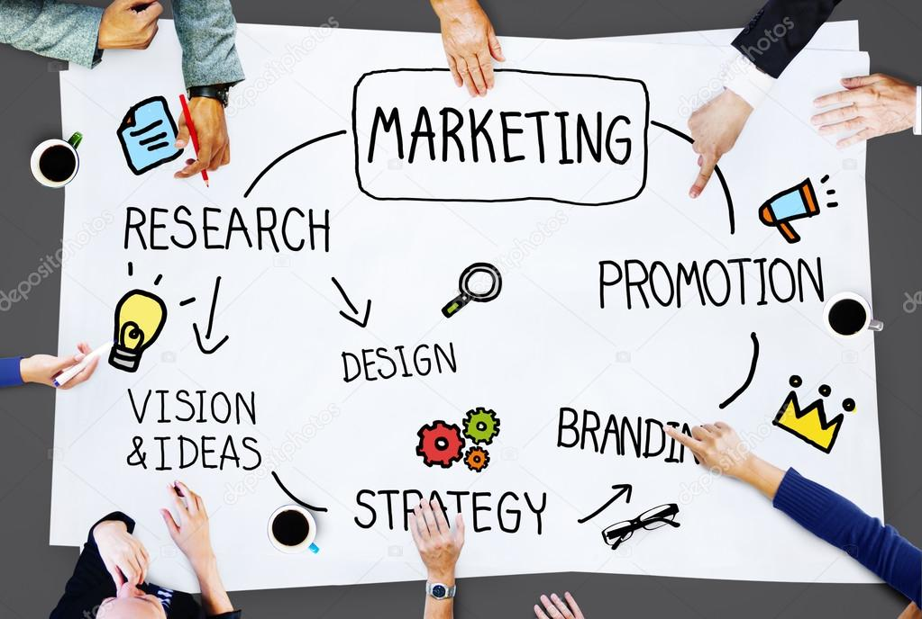
Objective:
To study the concept of customer satisfaction in general.
To study the brand awareness of products.
To identify the level of customer satisfaction towards the price and package of the product.
To analyse the customer preference towards the product.
Providing the offers like buy 1 get 1 free.
Promotions of brand new products.

Slide 4
Introduction:
Customer’s satisfaction can be considered as one of the key indicator of company’s future profits. The development of the customer’s satisfaction theory has led to the emergence of two perspectives.
The study of customer satisfaction through product performance became more important.
In general, satisfaction is a person’s feelings of pleasure or disappointment resulting from comparing products perceived performance relation to his/ her expectations.
If the performance matches the expectations, the customer is satisfied.
Customer satisfaction is a part of customer’s experience that exposes a supplier’s behavior on customer’s expectation and how promptly services are provided.
This satisfaction could be related to various business aspects like marketing.

Slide 5
Problem identification:
Recruiting talent.
Maintaining a sufficient budget.
Generating leads.
Finding the right tools.
Being risk-averse.
Moving into new markets.
Retaining customers.
Retaining and training staff.

Slide 6
Advantages:
Marketing Increases the National Income.
Marketing Helps in Optimal Utilization of Resources.
Marketing Facilitates Exchanges in the Ownership and Possession of Goods and Services.
Marketing Raises the Standard of Living
Marketing Provides Employment Opportunities.
Marketing Stabilizes the Economic Conditions.

Slide 7
Disadvantages:
Marketing can be expensive and drain profits, especially for smaller businesses
It's difficult to accurately assess the cost benefit of a marketing campaign
Not all campaigns are successful because they were not carefully researched and planned
The business may require additional staff to assist with advertising
The cost of branded items used for advertising reduces profit margins

Slide 8
Literature reviews:
Peterson etal, 2015: (JS)
Journal of Selling, 15 (1) (2015), pp. 29-43.
An ineffective marketing management decreases a firm's performance through salespeople rejecting qualified leads, below average conversion rates within the sales funnel, and poor efforts to generate demand, capture revenue, and gain a competitive advantage.
Johnson & Boeing, 2016:(JPSSM)
Journal of Personal Selling & Sales
Management, 36 (2) (2016), pp. 190-205.
It have been suggested in the marketing management literature as relevant factors that impact marketing management functioning.
They were expected to result in interesting insights into how the marketing management research domain evolved.

Slide 9
Hult, Morgeson, Morgan, Mithas, & Fornell, 2017:(JAMS)
Journal of the Academy of Marketing Science, 45 (1) (2017), pp. 37-54
To this effect, a firm's marketing and sales departments must collaborate to understand customers , and develop and implement effective marketing strategies. So the firm is able to deliver superior value to customers.
Palmatier, Houston, & Hulland, 2018:(JAMS)
Journal of the Academy of Marketing Science, 46 (1) (2018), pp. 1-5
The development in marketing management conceptual model to integrate and synthesize extant knowledge, highlight gaps in the body of extant research, and suggest avenues for future research that may help fill these gaps.
Gonzalez & Claro, 2019:(JAMS)
Journal of the Academy of Marketing Science, 47 (5) (2019), pp. 795-814
The daily interactions with customers, salespeople may collect market intelligence, share it with marketing, participate in development of marketing strategy and implement the strategy in the field thereby helping firms deliver superior customer value.

Slide 10
Methodology of marketing management:
The proposed methodology is dependent on the human factor – marketing specialists and their decision-making – which also limits its success.
The methodology is therefore not an attempt to replace humans, only to provide them with adequate support in decision-making or marketing management.
A marketing employee should be aware of the various kinds of interactions and synergistic effects which can occur.
Therefore, it is necessary for the management of marketing activities in this environment to equip the employee with knowledge which they can use as a basis for evaluating data acquired from the environment.
Within the methodology, it is primarily the properties of complex networks along with a search for key nodes or hubs with greater interaction potential, both across services and within each service.

Slide 11
Findings:
From this marketing management survey we can find that the maximum qualification is
master of business administration(MBA).
The minimum qualification is master in management (MIM),
the bachelor of business management is as follows in the pie chart.
We can find that the maximum / minimum experience is:
0-2 years =64%
2-4years=28%
4-6years=2%
6-10years=6%
We can find the department preferred by the people is :
Marketing - 54%
Finance -22%
Sales -18%
Advertising -6%
Suggestion provided by the people during the survey for the plans and strategies
for marketing is as follows:
Situation analysis.
Decision making.

Slide 12
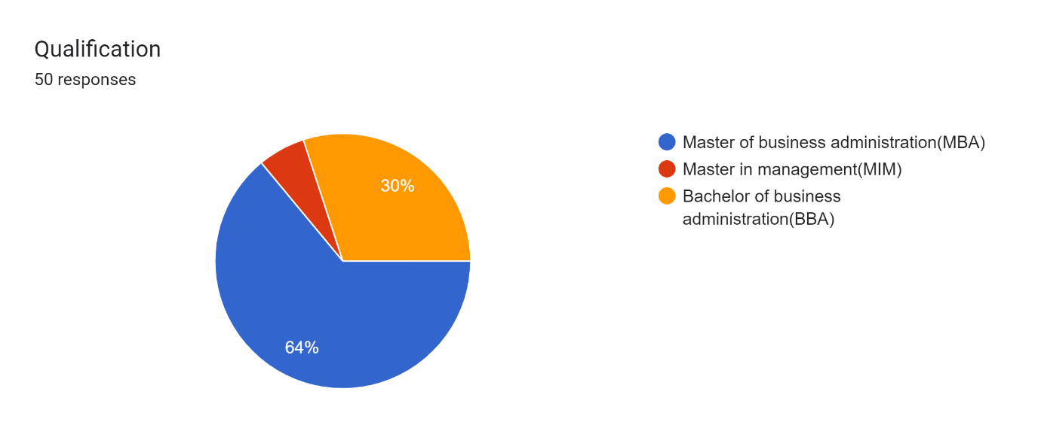
Data analysis:
Qualification: In this pie chart representation shows that qualification of different people who participated in this survey.

Slide 13
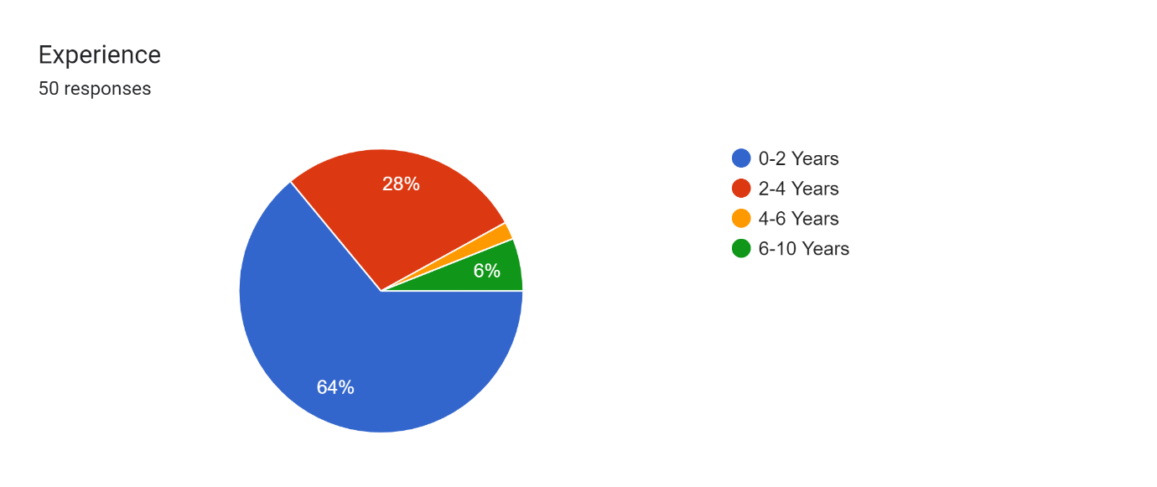
Experience: In this pie chart representation shows that experience of different people who participated in this survey.

Slide 14
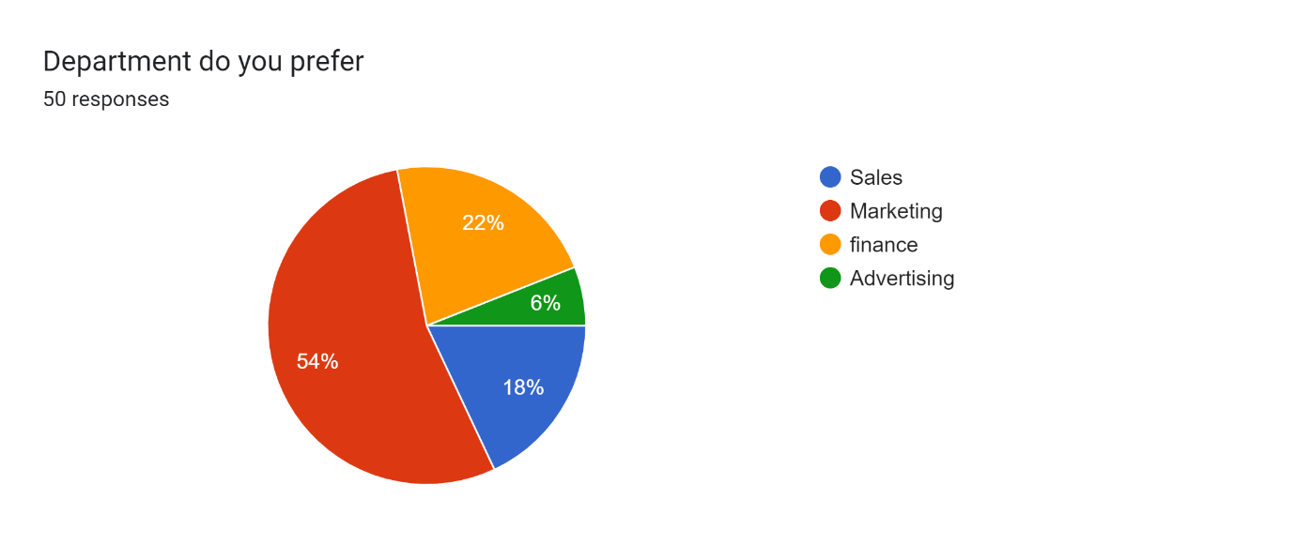
Department do you prefer: In this pie chart representation shows that departments which were people perefered who participated in this survey.

Slide 15
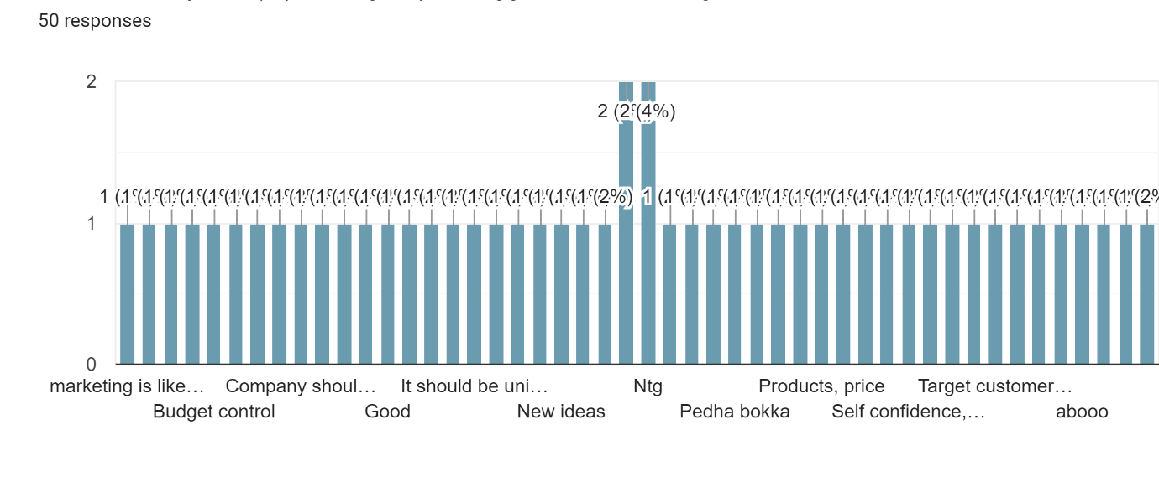
What are the plans (or) strategies you suggest for marketing: In this bar graph representation some plans and strategies suggested by the people who participated in this survey.

Slide 16
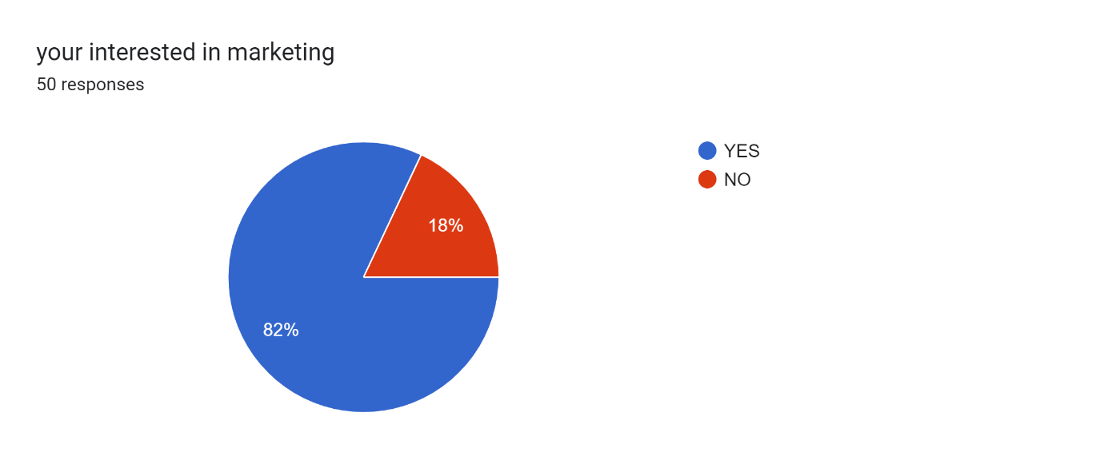
You’re interested in marketing: In this pie chart representation shows that peoples interest in marketing who participated in this survey.

Slide 17
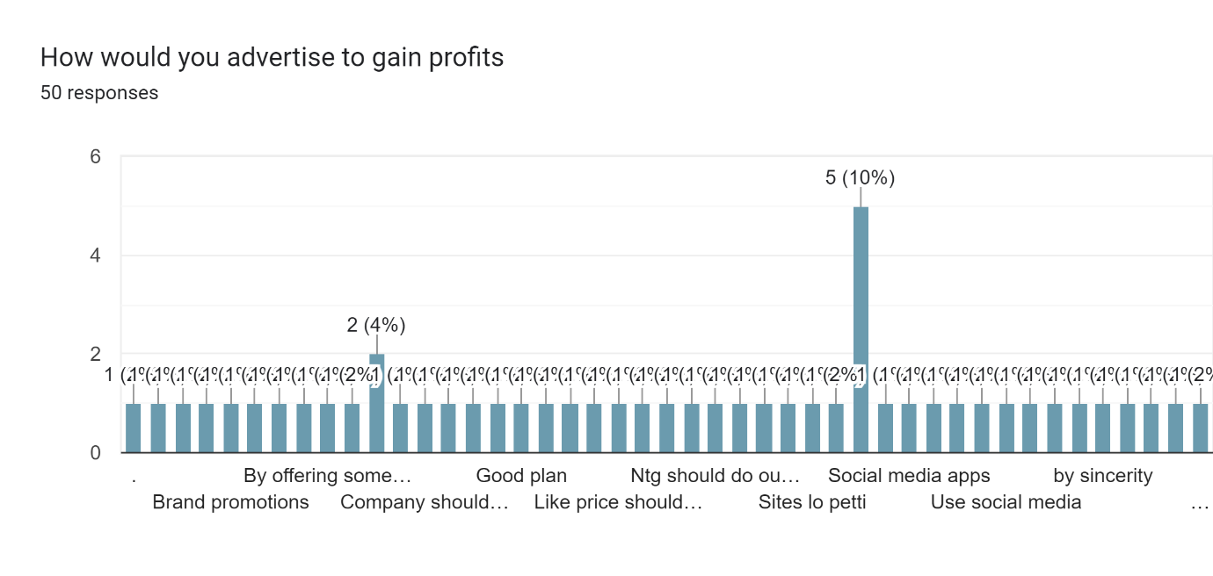
How would you advertise to gain profits: In this bar graph representation shows different ways to advertise to gain profit who participated in this survey.

Slide 18
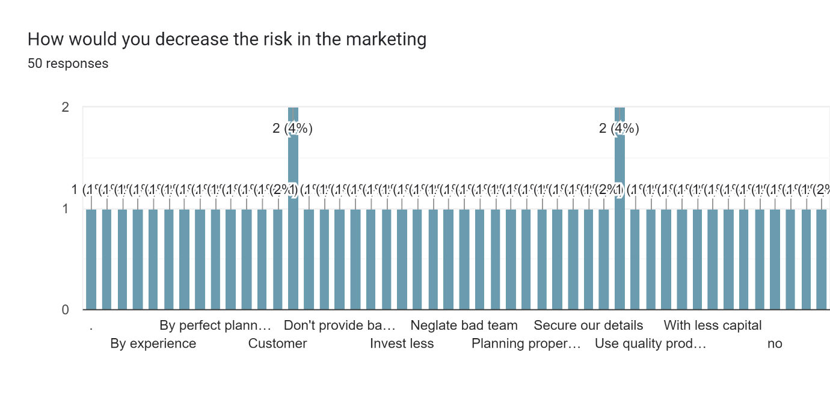
How would you decrease the risk in the marketing: In this bar graph representation shows that some suggestions given by the people to decrease risk in the marketing who participated in this survey.

Slide 19
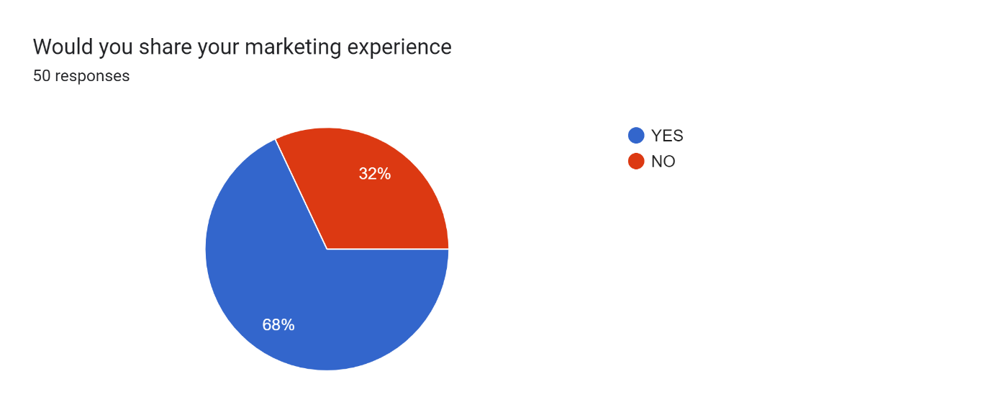
Would you share your marketing experience: In this pie chart representation shows that sharing their marketing experience who participated in this survey.

Slide 20
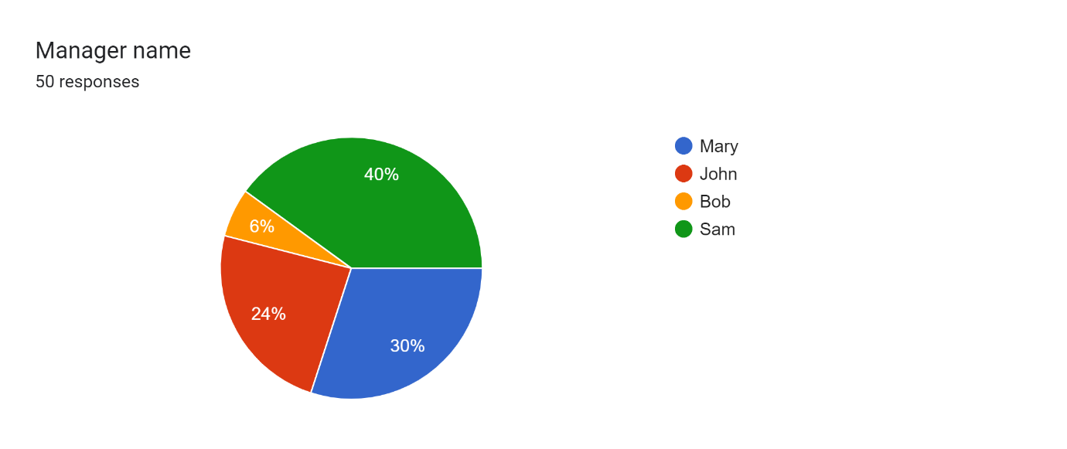
Manager name: In this pie chart representation shows that manager names in a following company selected by different people who participated in this survey.

Slide 21
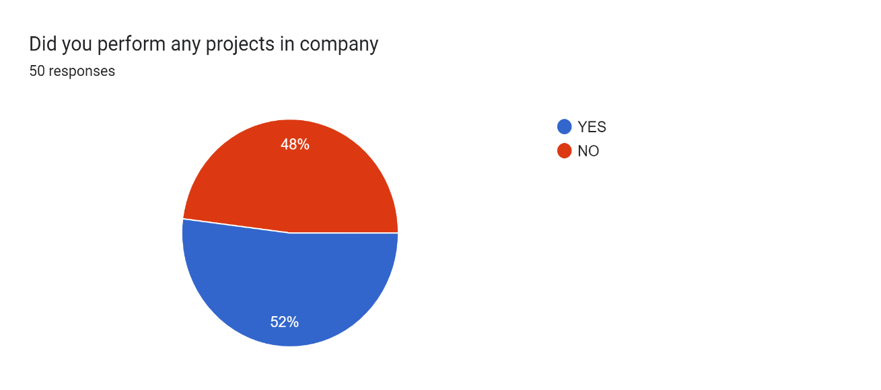
Did you perform any projects in company: In this pie chart representation shows that did they perform any project (or) not in a company of different people who participated in this survey.

Slide 22
Future enhancement:
Our systematic literature review not only serves to examine and synthesize the current body of work on marketing management, but also provides a foundation to derive future research directions.
suggests three major changes occurring in the world of sales and marketing:
a rapidly changing technological environment including big data's impact on sales and marketing practice.
the emergence of developing markets as strong players in a globalized world.
the changing roles of marketing and sales in increasingly competitive business environments.
the impact of digital technologies on marketing management.
the impact of national culture on marketing management.
the impact of the evolving roles of sales and marketing management.

Slide 23
Discussion:
The value of a systematic literature review is to “carefully identify and synthesize relevant literature to evaluate a substantive domain and thereby provide readers with a state-of-the-art understanding of the research topic”.
Based on what they consider the key benefits of review papers, we identify four major contributions of our literature review to the marketing management research domain.
First, we critically evaluated the methodological approaches and theories commonly used by marketing management researchers.
We showed that marketing management studies tend to be biased toward large companies with established sales and marketing departments in Western countries.
In addition, less than one third of the marketing management studies specify their theoretical grounding, with a strong emphasis on social identity, exchange, network, and interdependence theory.

Slide 24
Conclusion:
The functioning of a firm's marketing management is a key concern for both marketing scholars and executives.
Over 30 years, research in this domain has generated many useful insights about the nature and importance of marketing management.
At the same time, the marketing management literature lacks a clear, commonly accepted definition of the marketing management and a synthesis of our current understanding of marketing management.
In this article we define the scope of the marketing management, integrate and synthesize the extant marketing management literature, and develop several promising directions for future research.

Slide 25
Reference:
Peterson etal, 2015
When sales and marketing align: Impact on performance
Journal of Selling, 15 (1) (2015), pp. 29-43.
Johnson and Boeing, 2016
A união faz a força (there is strength in unity): Understanding the sales-marketing interface in Brasil
Journal of Personal Selling & Sales Management, 36 (2) (2016), pp. 190-205.
Hult, Morgeson, Morgan, Mithas and Fornell, 2017
Do managers know what their customers think and why?
Journal of the Academy of Marketing Science, 45 (1) (2017), pp. 37-54.
Palmatier, Houston and Hulland, 2018
Review articles: Purpose, process, and structure
Journal of the Academy of Marketing Science, 46 (1) (2018), pp. 1-5.
Gonzalez and Claro, 2019
How intrafirm intermediary salespeople connect sales to marketing and product development
Journal of the Academy of Marketing Science, 47 (5) (2019), pp. 795-814.

Slide 26


